Slide 1
Lesson 4
Computer Networking

Slide 2
Topic Objectives
To know about uses, applications, disadvantages of network
To elaborate various types of network
To elaborate various types of topologies

Slide 3
Networking
Computer network A collection of computing devices that are connected in various ways in order to communicate and share resources
Usually, the connections between computers in a network are made using physical wires or cables
However, some connections are wireless, using radio waves or infrared signals

Slide 4
Networking History
1961: Kleinrock - queuing theory shows effectiveness of packet-switching
1964: Baran - packet-switching in military applications for survivable networks
1967: ARPAnet conceived by Advanced Research Projects Agency
1969: First ARPAnet node operational
Prof.Kleinrock sends a message across from UCLA to Stanford
1972:
ARPAnet demonstrated publicly
NCP (Network Control Protocol) first host-host protocol
First e-mail program
ARPAnet has 15 nodes

Slide 5
Networking History
1970: ALOHAnet satellite network in Hawaii (CSMA developed), later connects to ARPANet
1973: Bob Metcalfe’s PhD thesis proposes Ethernet (CSMA/CD developed)
1974: Cerf and Kahn - architecture for interconnecting networks: the word “Internet” makes its appearance from Cerf’s writings

Slide 6
Networking History
Early 1990’s: ARPAnet decommissioned
Early 1990s: WWW
Hypertext (1945 Bush: “As We May Think” article, Ted Nelson, Engelbert, Andries in 1968 )
HTTP: Tim Berners-Lee develops WWW an Internet based hypermedia initiative at CERN, specifies URLs, HTTP and HTML which became basis for today’s WWW
1994: Mosaic (Univ. of Illinois), later Netscape the major browsers until late 1990’s
late 1990’s: commercialization of the WWW, with introduction of HTTPS e-commerce is realized
Late 1990’s:
est. 50 million computers on Internet
est. 100 million+ users
backbone links running at 1 Gbps

Slide 7
Networking
The generic term node or host refers to any device on a network
Data transfer rate The speed with which data is moved from one place on a network to another
Data transfer rate is a key issue in computer networks

Slide 8
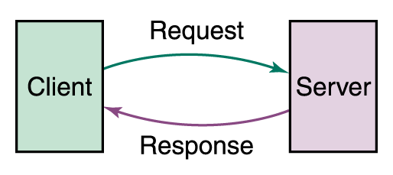
Networking
Computer networks have opened up an entire frontier in the world of computing called the client/server model
Client/Server interaction

Slide 9
Networking
File server A computer that stores and manages files for multiple users on a network
Web server A computer dedicated to responding to requests (from the browser client) for web pages

Slide 10
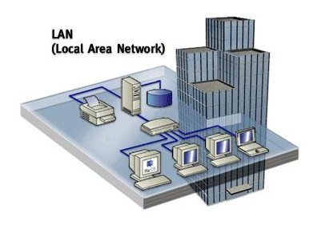
Types of Network
Local-area network (LAN) A network that connects a relatively small number of machines in a relatively close geographical area

Slide 11
Types of Networks
Various configurations, called topologies, have been used to administer LANs
Ring topology A configuration that connects all nodes in a closed loop on which messages travel in one direction
Star topology A configuration that centers around one node to which all others are connected and through which all messages are sent
Bus topology All nodes are connected to a single communication line that carries messages in both directions

Slide 12
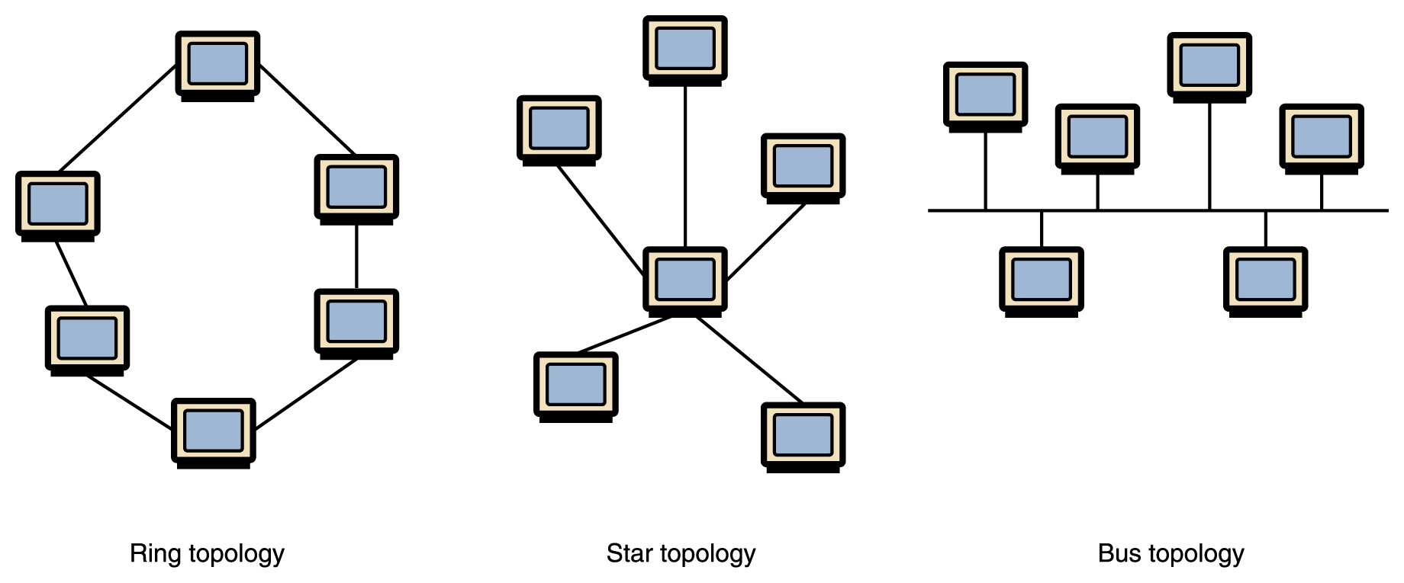
Types of Networks
Various network topologies
A bus technology called Ethernet has become the industry standard for local-area networks

Slide 13
Types of Networks
Wide-area network (WAN) A network that connects two or more local-area networks over a potentially large geographic distance
Often one particular node on a LAN is set up to serve as a gateway to handle all communication going between that LAN and other networks
Communication between networks is called internetworking
The Internet, as we know it today, is essentially the ultimate wide-area network, spanning the entire globe

Slide 14
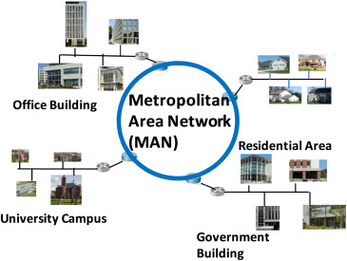
Types of Networks
Metropolitan-area network (MAN) The communication infrastructures that have been developed in and around large cities

Slide 15
So, who owns the Internet?
Well, nobody does. No single person or company owns the Internet or even controls it entirely. As a wide-area network, it is made up of many smaller networks. These smaller networks are often owned and managed by a person or organization. The Internet, then, is really defined by how connections can be made between these networks.

Slide 16
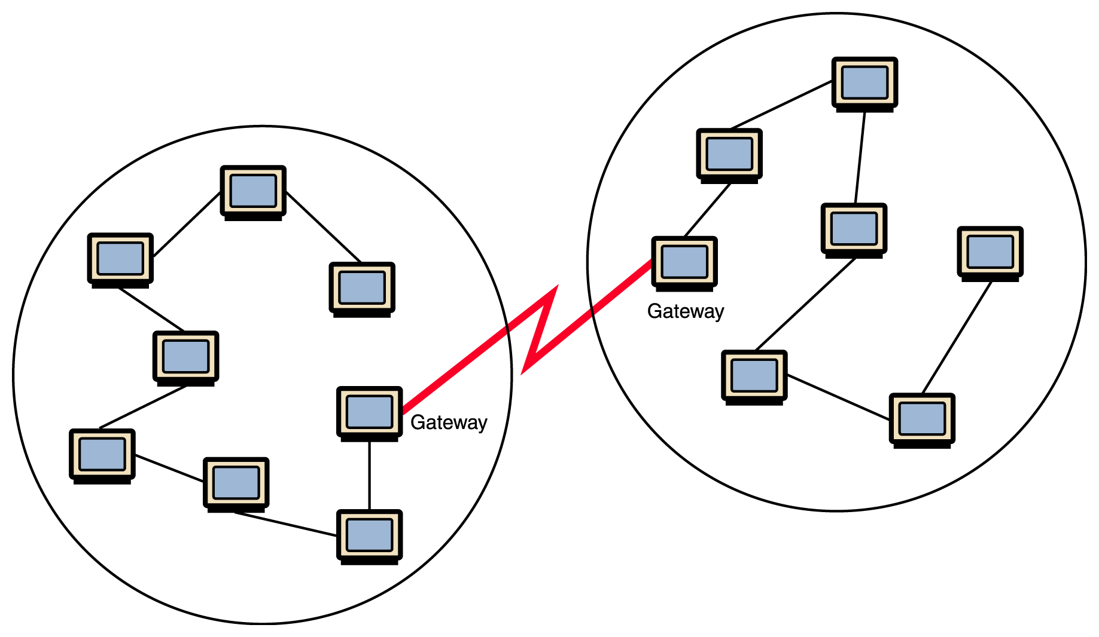
Types of Networks
Local-area networks connected across a distance to create a wide-area network

Slide 17
Internet Connections
Internet backbone A set of high-speed networks that carry Internet traffic
These networks are provided by companies such as AT&T, GTE, and IBM
Internet service provider (ISP) A company that provides other companies or individuals with access to the Internet

Slide 18
Internet Connections
There are various technologies available that you can use to connect a home computer to the Internet
A phone modem converts computer data into an analog audio signal for transfer over a telephone line, and then a modem at the destination converts it back again into data
A digital subscriber line (DSL) uses regular copper phone lines to transfer digital data to and from the phone company’s central office
A cable modem uses the same line that your cable TV signals come in on to transfer the data back and forth

Slide 19
Internet Connections
Broadband A connection in which transfer speeds are faster than 128 bits per second
DSL connections and cable modems are broadband connections
The speed for downloads (getting data from the Internet to your home computer) may not be the same as uploads (sending data from your home computer to the Internet)

Slide 20
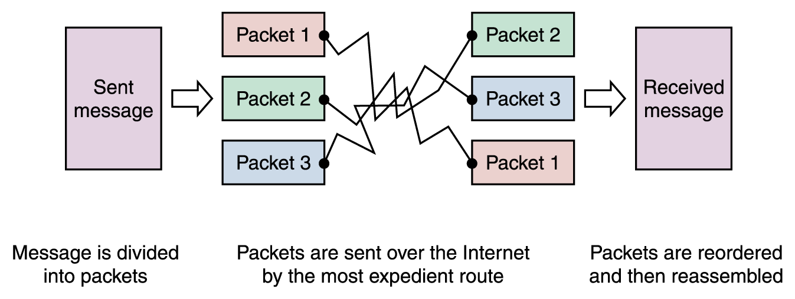
Packet Switching
To improve the efficiency of transferring information over a shared communication line, messages are divided into fixed-sized, numbered packets
Network devices called routers are used to direct packets between networks
Messages sent by packet switching

Slide 21
Open Systems
Proprietary system A system that uses technologies kept private by a particular commercial vendor
One system couldn’t communicate with another, leading to the need for
Interoperability The ability of software and hardware on multiple machines and from multiple commercial vendors to communicate
Leading to
Open systems Systems based on a common model of network architecture and a suite of protocols used in its implementation

Slide 22
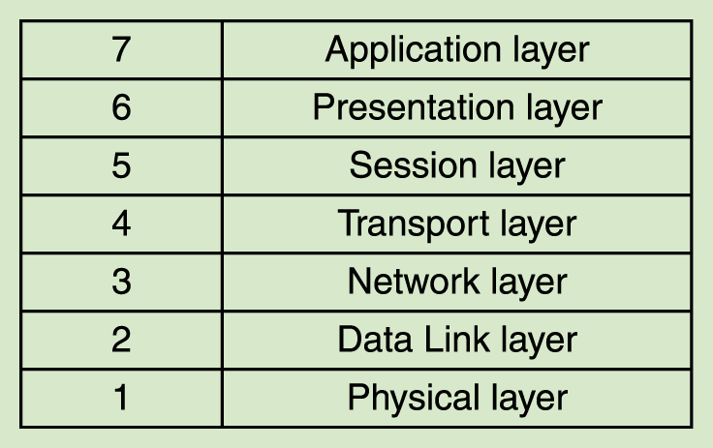
Open Systems
The International Organization for Standardization (ISO) established the Open Systems Interconnection (OSI) Reference Model
Each layer deals with a particular aspect of network communication
The layers of the OSI Reference Model

Slide 23
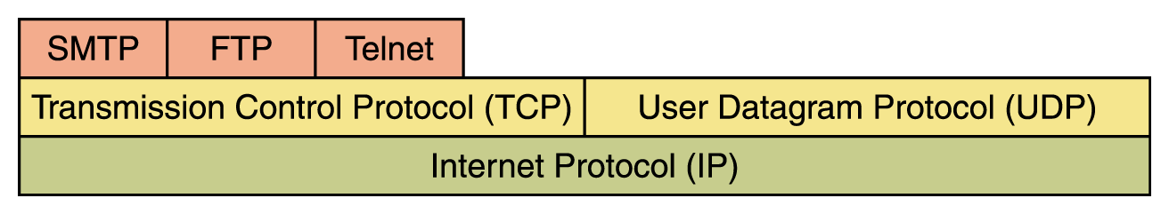
Network Protocols
Network protocols are layered such that each one relies on the protocols that underlie it
Sometimes referred to as a protocol stack
Layering of key network protocols

Slide 24
TCP/IP
TCP stands for Transmission Control Protocol
TCP software breaks messages into packets, hands them off to the IP software for delivery, and then orders and reassembles the packets at their destination
IP stands for Internet Protocol
IP software deals with the routing of packets through the maze of interconnected networks to their final destination

Slide 25
TCP/IP (cont.)
UDP stands for User Datagram Protocol
It is an alternative to TCP
The main difference is that TCP is highly reliable, at the cost of decreased performance, while UDP is less reliable, but generally faster

Slide 26
High-Level Protocols
Other protocols build on the foundation established by the TCP/IP protocol suite
Simple Mail Transfer Protocol (SMTP)
File Transfer Protocol (FTP)
Telnet
Hyper Text Transfer Protocol (http)

Slide 27
MIME Types
Related to the idea of network protocols and standardization is the concept of a file’s MIME type
MIME stands for Multipurpose Internet Mail Extension
Based on a document’s MIME type, an application program can decide how to deal with the data it is given

Slide 28
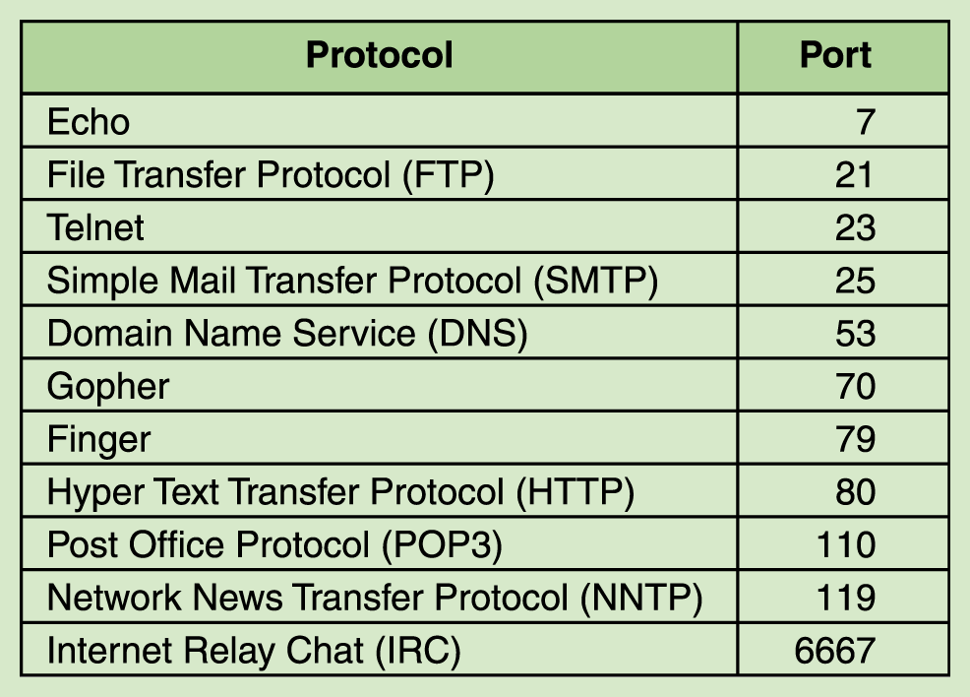
MIME Types
Some protocols and the ports they use

Slide 29
Firewalls
Firewall A machine and its software that serve as a special gateway to a network, protecting it from inappropriate access
Filters the network traffic that comes in, checking the validity of the messages as much as possible and perhaps denying some messages altogether
Enforces an organization’s access control policy

Slide 30
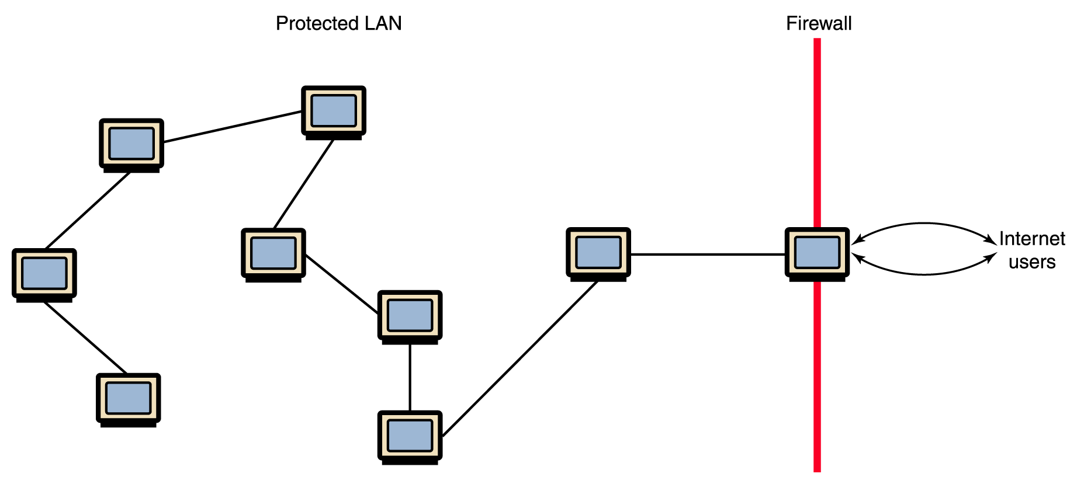
Firewalls
A firewall protecting a LAN

Slide 31
Network Addresses
Hostname A unique identification that specifies a particular computer on the Internet
For example
matisse.csc.villanova.edu
condor.develocorp.com

Slide 32
Network Addresses
Network software translates a hostname into its corresponding IP address
For example
205.39.145.18

Slide 33
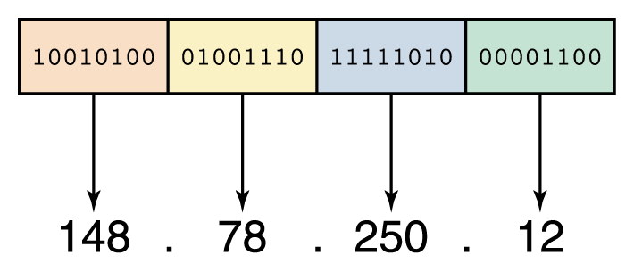
Network Addresses
An IP address can be split into
network address, which specifies a specific network
host number, which specifies a particular machine in that network
An IP address is stored in four bytes

Slide 34
Domain Name System
A hostname consists of the computer name followed by the domain name
csc.villanova.edu is the domain name
A domain name is separated into two or more sections that specify the organization, and possibly a subset of an organization, of which the computer is a part
Two organizations can have a computer named the same thing because the domain name makes it clear which one is being referred to

Slide 35
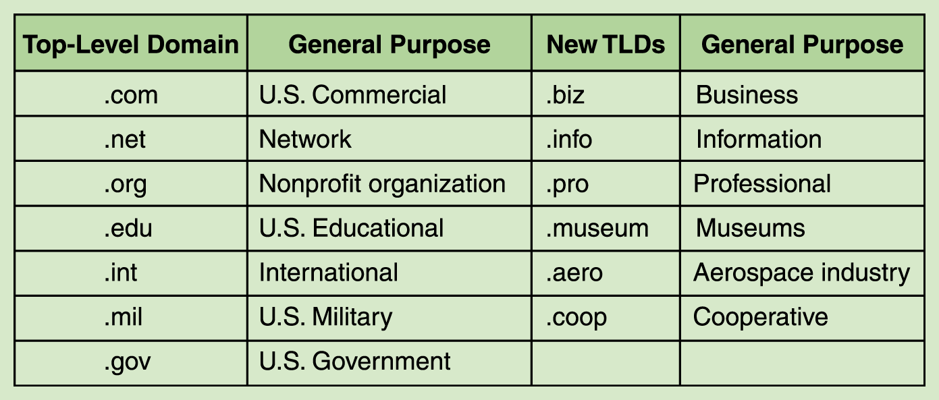
Domain Name System
The very last section of the domain is called its top-level domain (TLD) name
Top-level domains, including some relatively new ones

Slide 36
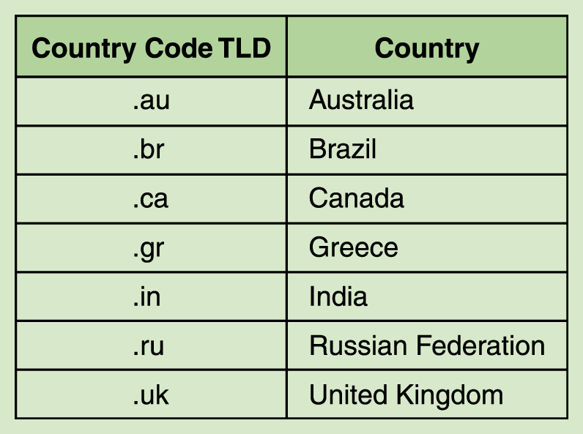
Domain Name System
Organizations based in countries other than the United States use a top-level domain that corresponds to their two-letter country codes
Some of the top-level domain names based on country codes

Slide 37
Domain Name System
The domain name system (DNS) is chiefly used to translate hostnames into numeric IP addresses
DNS is an example of a distributed database
If that server can resolve the hostname, it does so
If not, that server asks another domain name server

